Slide 1
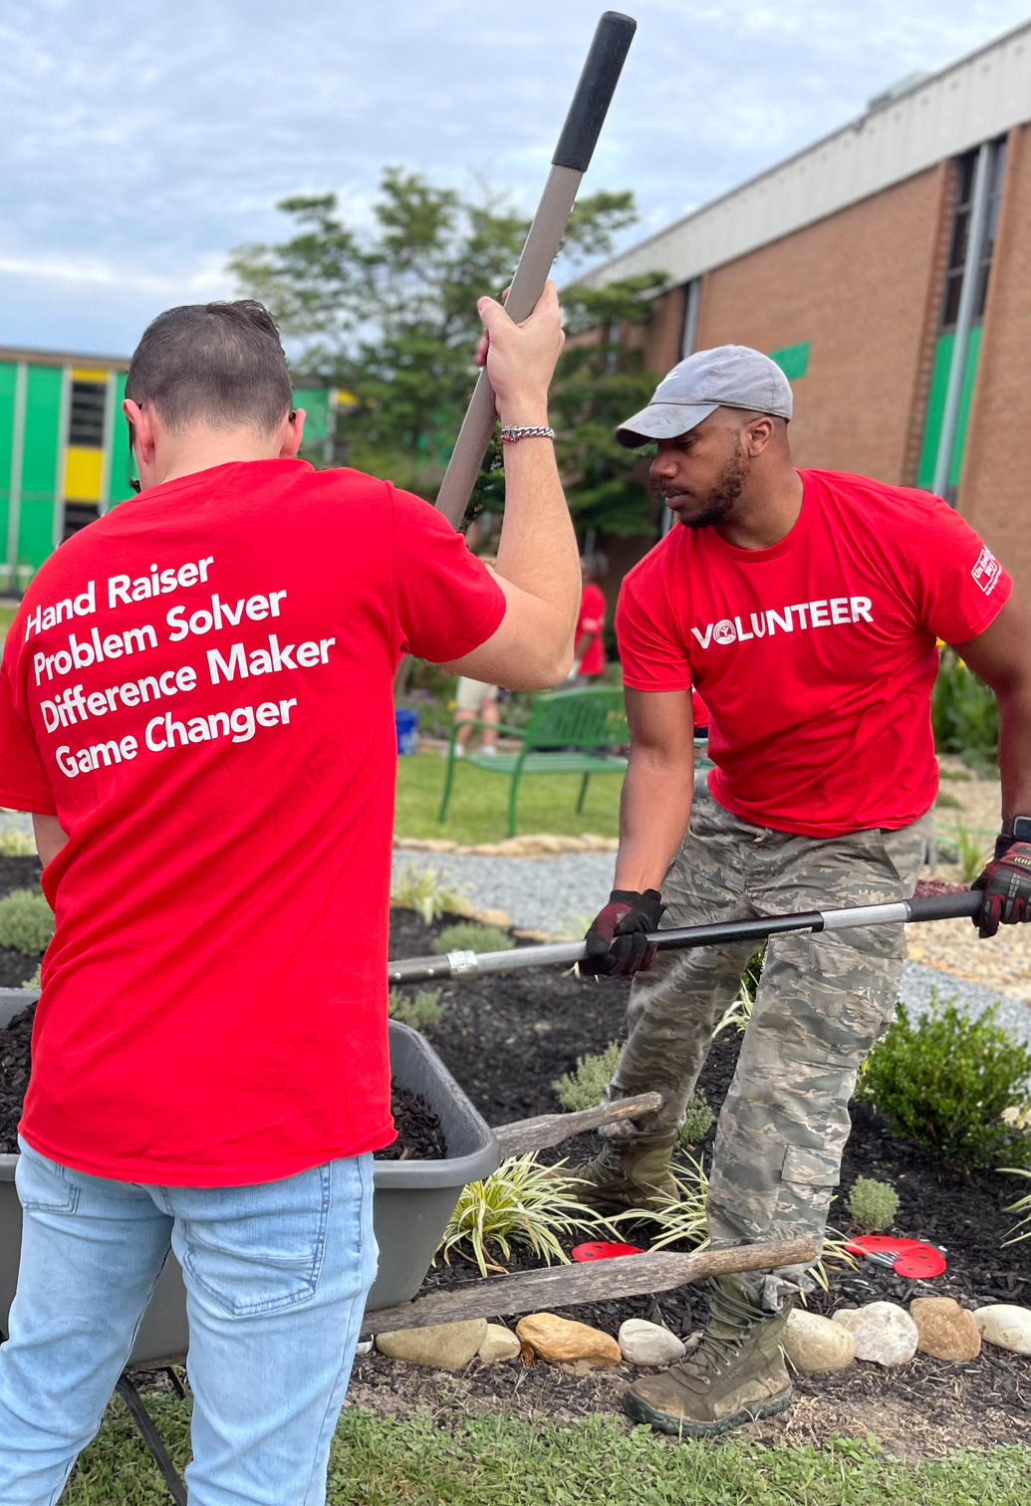
United Way of Wayne County
IT STARTS WITH
2023 Community Campaign
unitedwayne.org

Slide 2
Zach
My name is Zach. I do not read very well, but thanks to my boss, at NC Sounds & Security, I was referred to Literacy Connections, Adult Literacy Program. The tutor I met with in the evenings provided me with a great deal of confidence and before I knew it, I was able to step into a leadership role in my company. I am now pursuing additional courses at Wayne Community College. Thanks to this program, my wonderful tutor, and my supportive boss, I have learned that literacy is so much more than reading; it’s a doorway to a brighter future. The tools given to me by the Adult Literacy Program increased my ability to understand my medications, grow in my career, and engage with my community.
This is a true success story and a great example of how non-profits can work to improve lives, but this program would not exist, to the capacity it is, without the support of the United Way of Wayne County.
United Way of Wayne County

Slide 3
United Way of Wayne County measures their success in lives changed and they're asking you to partner with them to invest in our community by committing your fair share in 2024.
By pledging as little as one hour of pay per month for the coming year, you qualify for their annual fair share drawing and a chance to win $10,000 cash. But more than that, you are helping change the stories of individuals and families who are in need of health and human services right here in Wayne County.
unitedwayne.org
United Way of Wayne County

Slide 4
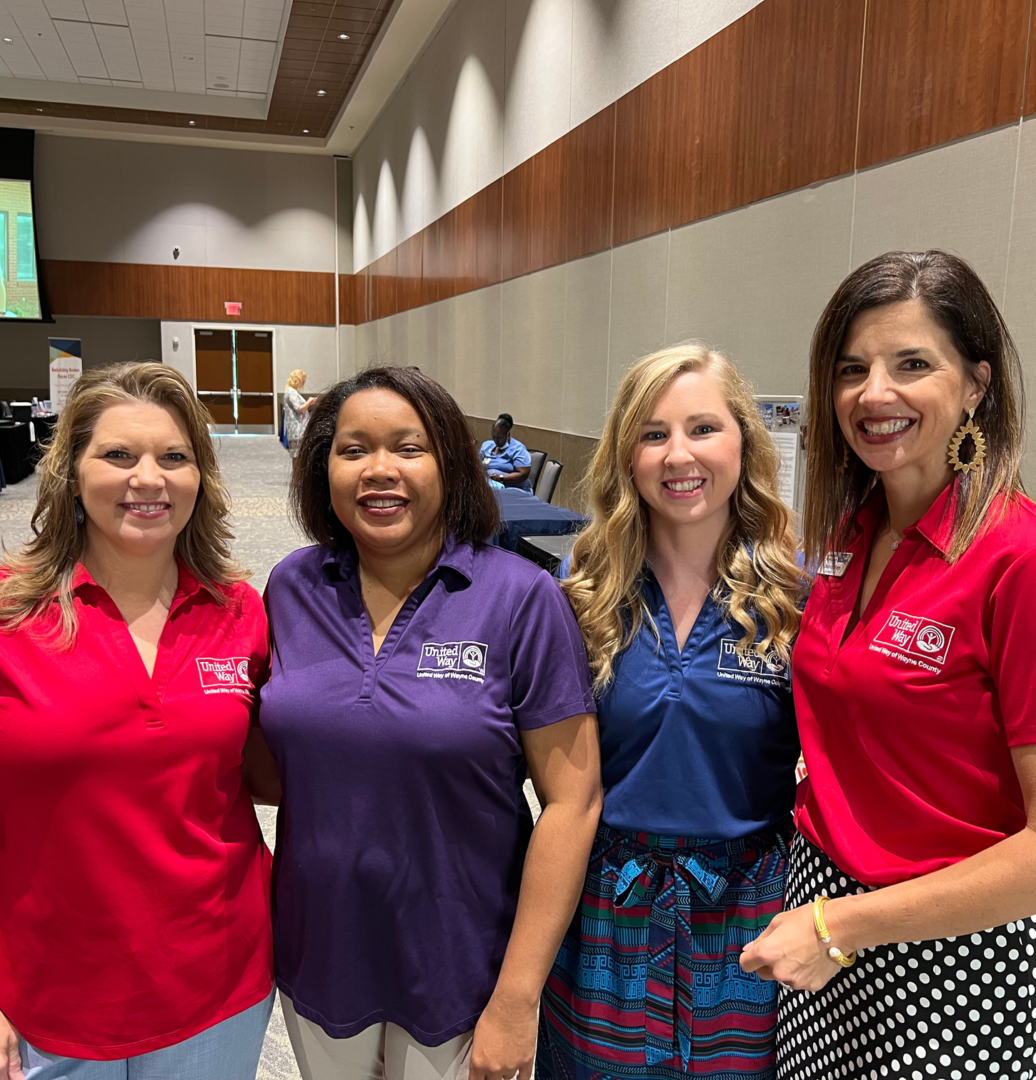
United Way of Wayne County
United Way of Wayne County has been serving our community for nearly 100 years (98 to be exact), by inviting our citizens to invest in life-changing programs and address community needs with solutions!
United Way of Wayne County

Slide 5
Mission
EDUCATION
FINANCIAL
STABILITY
Their mission is to connect all Wayne County citizens with programs & referrals to assist with education, health and wellness, financial stability, and basic needs.
BASIC
NEEDS
HEALTH &
WELLNESS
unitedwayne.org
United Way of Wayne County

Slide 6
Community Partners
United Way of Wayne County supports 20 programs from 14 agencies right here in our community!
unitedwayne.org
United Way of Wayne County

Slide 7
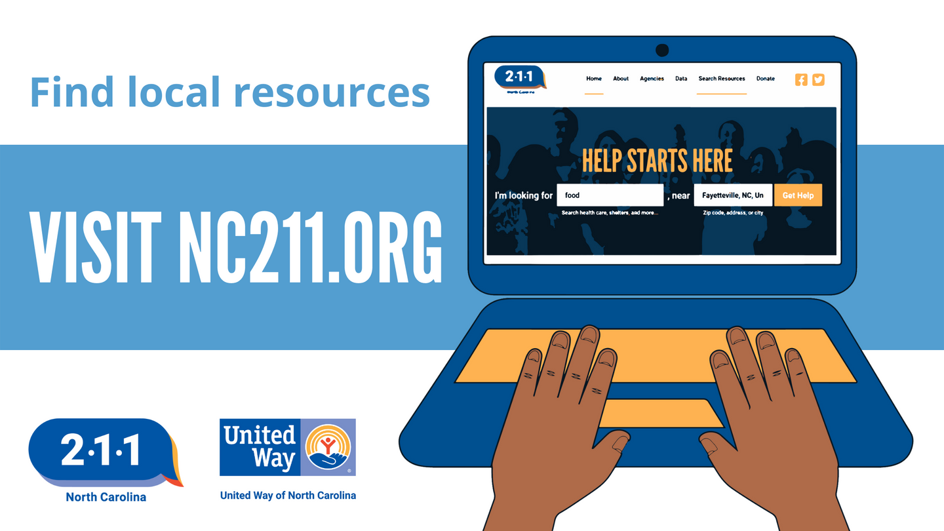
NC 2-1-1
In addition to the programs listed, United Way also supports 2-1-1, a health and human services call center. 2-1-1 is available 24/7, 365 days a year, and in multiple languages. Families and individuals can dial 2-1-1 to obtain free and confidential information pertaining to food, shelter, utility assistance, housing, parenting resources, healthcare, substance abuse, as well as specific resources for older adults and persons with disabilities, and much more.
unitedwayne.org
United Way of Wayne County

Slide 8
Nina
I am a mother of three. In 2015 I found myself struggling financially. I couldn’t pay my bills and was about to get evicted from our home. I was lost and didn’t know what to do. I was referred to the Society of St. Vincent De Paul’s Emergency Assistance Program for help. Their support allowed me to become finically self-sufficient. I was able to begin working at Walmart and continued there for four years, but still needed a second job to help pay bills. I worked both jobs all while working towards my associate degree in human services. I was starting to feel more in control. However, in 2020, I found myself very sick. When tested, it turned out I was COVID-positive and couldn’t return to work for two weeks. This was a huge setback for me because without that income I found myself again unable to provide for my family. Fortunately, I was able to call on the Society of St. Vincent de Paul again and was provided with two months’ rent to get me back on track to self-sufficiency.
This is a true success story, but without the work and support of United Way of Wayne County, this program would not exist.
United Way of Wayne County

Slide 9
By pledging only one hour of pay per month starting in 2024, you can help rewrite the success of one’s life. United Way of Wayne County's goal is to rewrite the stories of 17,000 lives. They invites you to be the story of change. It starts with you and ends with improving lives in our community.
UNITED, WE'RE
THE STORY
CHANGE
F
Contact us to get more info
THANK YOU,
FOR YOUR SUPPORT!
savannah@unitedwayne.org
2803 Cashwell Drive, Ste B, Goldsboro
919-735-3591
unitedwayne.org
United Way of Wayne County

